Slide 1
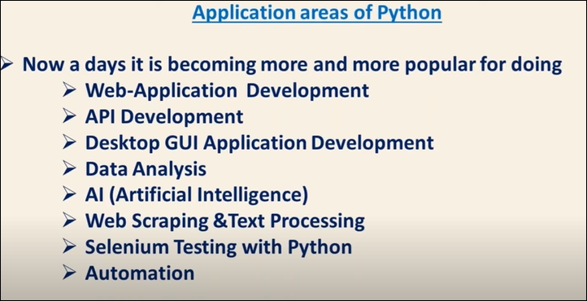

Slide 2
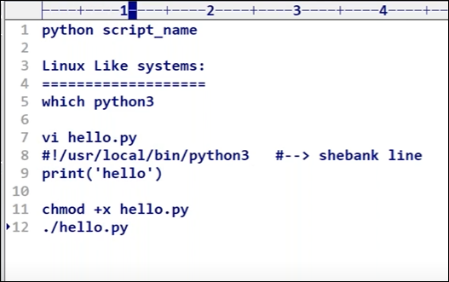

Slide 3
Relative Path- Path name respected to a current directory name.
Absolute path – path name from c or d drvie.
Epoch time starts from – 1-jan-1970
Calculation happens in second passed from current time to 1-Jan-1970.

Slide 4
SMTP Module
SMTP Module used for sending mail.
SMTP is a protocol

Slide 5
